Slide 1


LECTURE 2
Linear
regression
Foundations of Artificial Intelligence
SEMTM0051 · 2026/27
Lecturer: Dr Roberto Colomboni
Notes:
Lecture 2: Linear regression. From a prediction problem and empirical loss to least squares, feature expansion and gradient descent.
Visual sources: University of Bristol official logo, https://www.bristol.ac.uk/assets/responsive-web-project/2.7.4/images/logos/uob-logo.svg (downloaded 21 September 2026). Fry Building atrium photograph, WilkinsonEyre, https://wilkinsoneyre.com/projects/university-of-bristol-fry-building ; original image https://wilkinsoneyre.com/images/containers/assets/projects/fry-building/834_n91_16-10-2.jpg/a034f46f36b4bd9bff159b579cfb2daf/834_n91_16-10-2.webp .

Slide 2
Today's lecture
Regression and loss functions
Least-squares fitting
Gradient descent
Extensions
00
Notes:
Source: SEMTM0051_week2_linear_regression_final (2)(1).tex, supplied by Roberto Colomboni.

Slide 3
Today's lecture
Regression and loss functions
Least-squares fitting
Gradient descent
Extensions
01
Notes:
Source: SEMTM0051_week2_linear_regression_final (2)(1).tex, supplied by Roberto Colomboni.

Slide 4





Regression: predicting a numerical outcome
We observe $N$ input–target pairs $\left(x_{1},y_{1}\right),…,\left(x_{N},y_{N}\right)∈ℝ^{2}$.
We model each outcome as a relationship plus noise.
$$f_{true}$$
$$y_{i}=f_{true}\left(x_{i}\right)+ε_{i}$$
$$ε_{i}$$
$$i=1,…,N$$
The vertical segments represent the noise terms $ε_{i}$.
The relationship $f_{true}$ and the noise terms $ε_{i}$ are unknown.
02
Notes:
Illustrative observations generated from a smooth unknown relationship with additive noise. The curve is drawn only to explain the modelling assumption and is not known to the learner. Initially the scatter plot is visible. One click reveals the true relationship, vertical noise segments, the additive-noise equation and the unknown-quantity statement. For this schematic, f(x)=0.65x²+0.55x+0.4. Each vertical segment joins (x_i,f(x_i)) to (x_i,y_i). Noise is y_i-f(x_i), with both signs. These illustrative data are separate from the five-point numerical example used later.

Slide 5
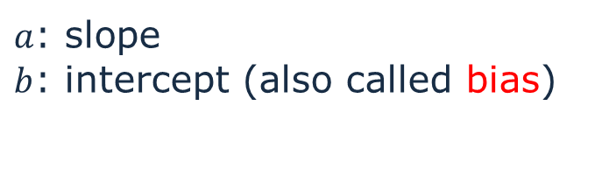


An affine relationship
As a first special case, suppose the unknown relationship is affine.
$$f_{true}\left(x\right)=ax+b$$
$$y_{i}=ax_{i}+b+ε_{i}$$
$a$: slope
$b$: intercept (also called bias)
The observed points need not lie exactly on the unknown line because of the $ε_{i}$
03
Notes:
This is a single input feature displayed in the two-dimensional (x,y) plane. The line shown is a candidate, not a known true generating line.
Source: SEMTM0051_week2_linear_regression_final (2)(1).tex, supplied by Roberto Colomboni.

Slide 6




Several possible prediction lines
We do not know the true slope or intercept of $f_{true}$.
In general, there won’t be any straight line that passes through all points.
So… which line should we use as our estimate?
$$f\left(x\right)=1+2x$$
$$g\left(x\right)=1−x$$
$$h\left(x\right)=2$$
04
Notes:
Source: SEMTM0051_week2_linear_regression_final (2)(1).tex, supplied by Roberto Colomboni.

Slide 7



Comparing prediction errors
The vertical segments join each observation to its prediction.
$$f\left(x\right)=1+2x$$
$$g\left(x\right)=1−x$$
$$h\left(x\right)=2$$
We look at the residuals: residual = prediction − target
05
Notes:
Residual sign convention throughout: prediction minus target. Orange segments show residual magnitude.
Source: SEMTM0051_week2_linear_regression_final (2)(1).tex, supplied by Roberto Colomboni.
All three candidates f(x)=1+2x, g(x)=1−x, and h(x)=2 are compared on the same five observations. Each orange segment joins the target to its prediction. Residual means prediction minus target.

Slide 8


Loss functions
A loss assigns a penalty to one prediction $\hat{y}$ and its target $y$.
$$ℓ_{abs}\left(\hat{y},y\right)=\left|\hat{y}−y\right|$$
$$ℓ_{sq}\left(\hat{y},y\right)={\left(\hat{y}−y\right)}^{2}$$
Squared loss is differentiable everywhere:
we can use differential calculus directly.
Absolute loss has a kink at zero.
Doubling the error doubles its absolute penalty and quadruples its squared penalty.
06
Notes:
Both penalties are valid. Choice of loss should reflect the application. Squared loss is differentiable everywhere, absolute loss has a corner at zero.
Source: SEMTM0051_week2_linear_regression_final (2)(1).tex, supplied by Roberto Colomboni.
Click sequence: 1 absolute-loss formula; 2 absolute-loss curve only; 3 squared-loss formula; 4 the squared-loss curve is added to the same axes and both comments appear. Squared loss has derivative 2r and constant second derivative 2 with respect to the residual r. With predictors affine in their parameters, the empirical squared loss is a convex quadratic, and stationarity gives linear normal equations. Absolute loss is also convex; convexity alone does not distinguish the two. Squaring gives larger errors more influence and increases sensitivity to outliers, so this is a modelling choice rather than a universal advantage.

Slide 9



Empirical loss
Let $θ$ collect the parameters of the predictor $f_{θ}$.
We add the losses over all observed pairs $\left(x_{1},y_{1}\right),…,\left(x_{N},y_{N}\right)$.
$$ℒ_{abs}\left(θ\right)=\sum_{i=1}^{N}{ℓ_{abs}\left(f_{θ}\left(x_{i}\right),y_{i}\right)}=\sum_{i=1}^{N}{\left|f_{θ}\left(x_{i}\right)−y_{i}\right|}$$
$$ℒ_{sq}\left(θ\right)=\sum_{i=1}^{N}{ℓ_{sq}\left(f_{θ}\left(x_{i}\right),y_{i}\right)}=\sum_{i=1}^{N}{{\left(f_{θ}\left(x_{i}\right)−y_{i}\right)}^{2}}$$
The data stay fixed. The parameters vary.
07
Notes:
The parameter vector is a column. Empirical losses below use sums, matching the notes. Introduce the generic family notation before minimisation.
Source: SEMTM0051_week2_linear_regression_final (2)(1).tex, supplied by Roberto Colomboni.

Slide 10
Choosing the loss
The loss should reflect the goal of the application.
Squared loss is smooth and convenient for differentiation.
It also gives large errors more influence.
Absolute loss is a valid alternative.
Its corner at zero needs a different treatment in some optimisation arguments.
We focus on squared loss in this lecture.
08
Notes:
Absolute loss is convex and useful but nonsmooth. Do not imply that smoothness makes squared loss universally preferable. Empirical fit is distinct from generalisation.
Source: SEMTM0051_week2_linear_regression_final (2)(1).tex, supplied by Roberto Colomboni.

Slide 11
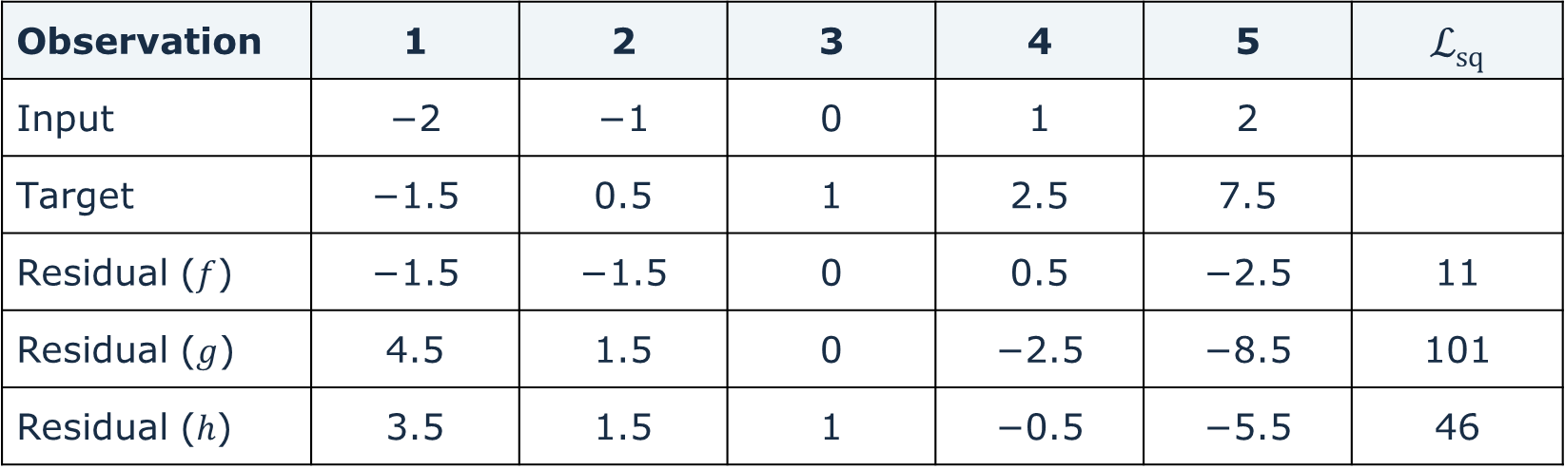
Comparing the candidates numerically
$$f\left(x\right)=1+2x, g\left(x\right)=1−x, h\left(x\right)=2$$
Observation | 1 | 2 | 3 | 4 | 5 | ℒ_{sq}
Input | −2 | −1 | 0 | 1 | 2
Target | −1.5 | 0.5 | 1 | 2.5 | 7.5
Residual ($f$) | −1.5 | −1.5 | 0 | 0.5 | −2.5 | 11
Residual ($g$) | 4.5 | 1.5 | 0 | −2.5 | −8.5 | 101
Residual ($h$) | 3.5 | 1.5 | 1 | −0.5 | −5.5 | 46
The squared-error criterion prefers the first candidate.
This comparison does not yet identify the best line among all possible lines.
09
Notes:
Source: SEMTM0051_week2_linear_regression_final (2)(1).tex, supplied by Roberto Colomboni.
Third candidate h(x)=2: residuals (3.5,1.5,1,−0.5,−5.5), squared loss 46. The losses of f,g,h are 11,101,46 respectively, so f is preferred among these three. Later, h is identified as the optimal constant predictor.

Slide 12
Today's lecture
Regression and loss functions
Least-squares fitting
Gradient descent
Extensions
10
Notes:
Source: SEMTM0051_week2_linear_regression_final (2)(1).tex, supplied by Roberto Colomboni.

Slide 13
Finding a minimum
Fermat’s theorem: minima are stationary points.
A differentiable objective has zero gradient at a local minimum.
$$∇ℒ_{sq}\left(θ\right)=0$$
We first find the stationary points, then check whether they are minima.
11
Notes:
Fermat applies since these are differentiable polynomials on an unconstrained Euclidean parameter space. Stationarity alone is not sufficient for a general function.
Source: SEMTM0051_week2_linear_regression_final (2)(1).tex, supplied by Roberto Colomboni.
Figure source: FigPredictorFamilies in the supplied lecture notes. Original graph definitions, colours, ranges and labels reproduced from the source.

Slide 14


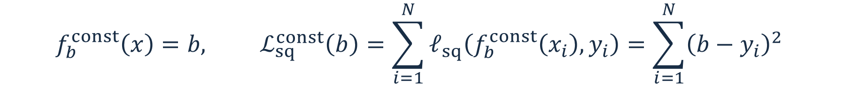
A constant predictor
Set $a=0$. The predictor returns the same value $b$ at every input.
$$f_{b}^{const}\left(x\right)=b, ℒ_{sq}^{const}\left(b\right)=\sum_{i=1}^{N}{ℓ_{sq}\left(f_{b}^{const}\left(x_{i}\right),y_{i}\right)}=\sum_{i=1}^{N}{{\left(b−y_{i}\right)}^{2}}$$
Prediction as a function of input
Loss as a function of the parameter
How do we find $b^{∗}$?
$b^{∗}$ is a stationary point of $ℒ_{sq}^{const}$!
12
Notes:
Distinguish the input coordinate x in the left plot from parameter b in the right plot. The illustrated b=0 has loss 66.
Source: SEMTM0051_week2_linear_regression_final (2)(1).tex, supplied by Roberto Colomboni.

Slide 15

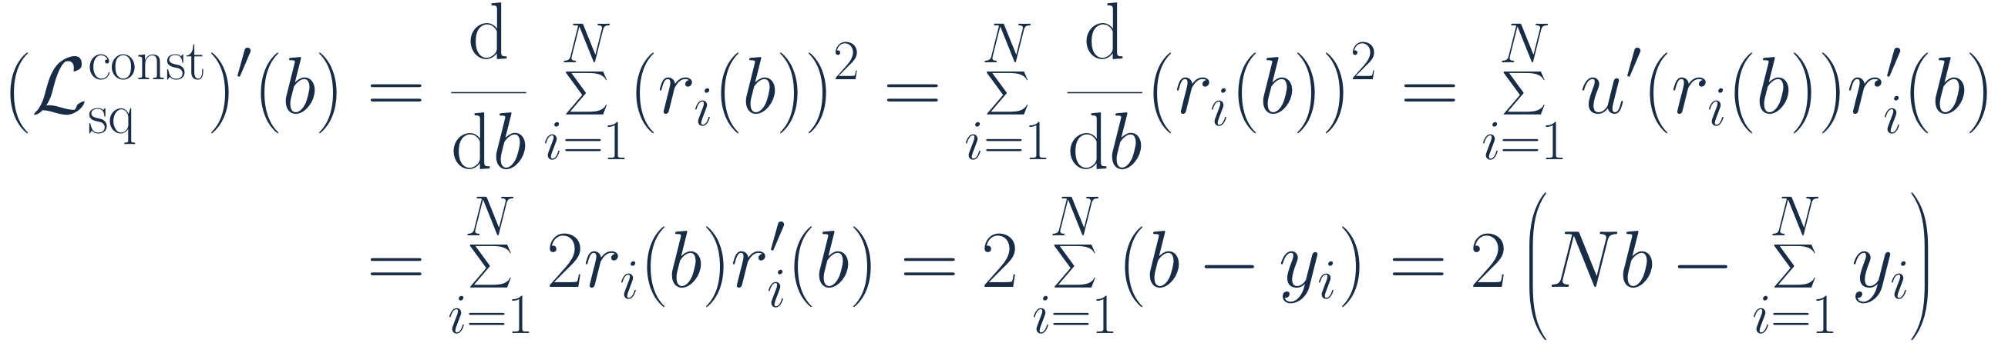
Differentiating the constant-predictor loss
$$ℒ_{sq}^{const}\left(b\right)=\sum_{i=1}^{N}{{\left(b−y_{i}\right)}^{2}}=\sum_{i=1}^{N}{{\left(r_{i}\left(b\right)\right)}^{2}}$$
where $r_{i}\left(b\right)=b−y_{i}$ is the i-th residual, so $r_{i}^{′}\left(b\right)=1$.
The chain rule, with outer function $u\left(r\right)=r^{2}$, and inner functions $r_{i}$ gives
$${\left(ℒ_{sq}^{const}\right)}^{′}\left(b\right)=\frac{d}{db}\sum_{i=1}^{N}{{\left(r_{i}\left(b\right)\right)}^{2}}=\sum_{i=1}^{N}{\frac{d}{db}{\left(r_{i}\left(b\right)\right)}^{2}}=\sum_{i=1}^{N}{u^{′}\left(r_{i}\left(b\right)\right)r_{i}^{′}\left(b\right)}$$
$$=\sum_{i=1}^{N}{2r_{i}\left(b\right)r_{i}^{′}\left(b\right)} =2\sum_{i=1}^{N}{\left(b−y_{i}\right)}=2\left(Nb−\sum_{i=1}^{N}{y_{i}}\right)$$
The targets $y_{i}$ are fixed. The parameter $b$ does not depend on $i$.
13
Notes:
Write the loss explicitly as a sum of squared residuals. Define each residual and note that its derivative is one because the target is fixed. Apply the chain rule to each squared residual, then collect the terms in b.
Source: SEMTM0051_week2_linear_regression_final (2)(1).tex, supplied by Roberto Colomboni.

Slide 16


The best constant is the sample mean
$${\left(ℒ_{sq}^{const}\right)}^{′}\left(b\right)=0 ⇔ Nb=\sum_{i=1}^{N}{y_{i}}$$
$$b^{∗}=\frac{1}{N}\sum_{i=1}^{N}{y_{i}}=\overline{y}$$
The loss is a quadratic in $b$ with positive leading coefficient $N$.
Its graph is an upward-opening parabola, so a global minimum exists.
By Fermat, every minimiser must be stationary.
There is only one stationary point, so it is the unique global minimiser.
14
Notes:
Source: SEMTM0051_week2_linear_regression_final (2)(1).tex, supplied by Roberto Colomboni.

Slide 17
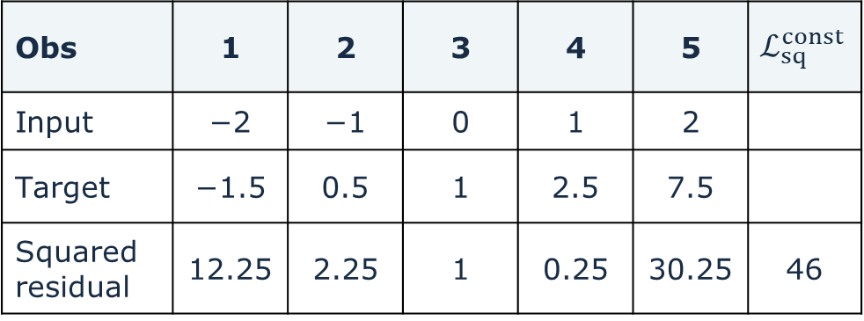

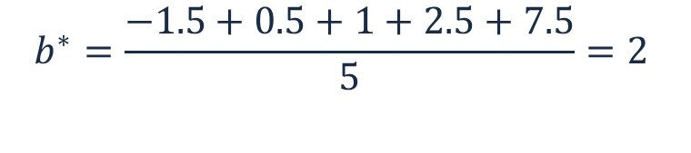
The constant fit on our data
Obs | 1 | 2 | 3 | 4 | 5 | $$ℒ_{sq}^{const}$$
Input | −2 | −1 | 0 | 1 | 2
Target | −1.5 | 0.5 | 1 | 2.5 | 7.5
Squared residual | 12.25 | 2.25 | 1 | 0.25 | 30.25 | 46
$$b^{∗}=\frac{−1.5+0.5+1+2.5+7.5}{5}=2$$
$$ℒ_{sq}^{const}\left(b^{∗}\right)=\text{46}$$
Exercise: keep the constant family and replace squared loss with
absolute loss
Which constant minimises the empirical loss?
15
Notes:
Absolute-loss exercise answer: the unique median is b=1 and absolute empirical loss is 11. Leave this answer off the visible slide.
Source: SEMTM0051_week2_linear_regression_final (2)(1).tex, supplied by Roberto Colomboni.

Slide 18
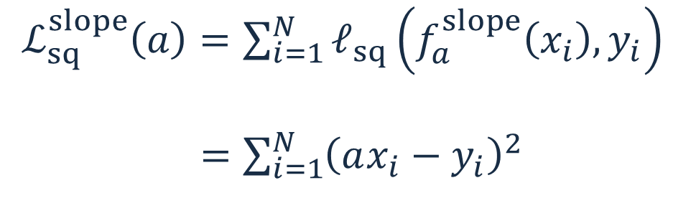

A line through the origin
Set $b=0$. The only adjustable parameter is the slope $a$.
$$f_{a}^{slope}\left(x\right)=ax$$
$ℒ_{sq}^{slope}\left(a\right)=\sum_{i=1}^{N}{ℓ_{sq}\left(f_{a}^{slope}\left(x_{i}\right),y_{i}\right)}$
$=\sum_{i=1}^{N}{{\left(ax_{i}−y_{i}\right)}^{2}}$
Every predictor in this family passes through the origin.
16
Notes:
Source: SEMTM0051_week2_linear_regression_final (2)(1).tex, supplied by Roberto Colomboni.

Slide 19



Differentiating with respect to the slope
$$ℒ_{sq}^{slope}\left(a\right)=\sum_{i=1}^{N}{{\left(ax_{i}−y_{i}\right)}^{2}}=\sum_{i=1}^{N}{r_{i}}{\left(a\right)}^{2}$$
where $r_{i}\left(a\right)=ax_{i}−y_{i}$ is the i-th residual, so $r_{i}^{′}\left(a\right)=x_{i}$.
The chain rule, with outer function $u\left(r\right)=r^{2}$, and inner functions $r_{i}$ gives
$${\left(ℒ_{sq}^{slope}\right)}^{′}\left(a\right)=\frac{d}{da}\sum_{i=1}^{N}{{\left(r_{i}\left(a\right)\right)}^{2}}=\sum_{i=1}^{N}{\frac{d}{da}{\left(r_{i}\left(a\right)\right)}^{2}}$$
$$=\sum_{i=1}^{N}{2r_{i}\left(a\right)r_{i}^{′}\left(a\right)} =2\sum_{i=1}^{N}{\left(ax_{i}−y_{i}\right)x_{i}}=2\left(a\sum_{i=1}^{N}{x_{i}^{2}}−\sum_{i=1}^{N}{x_{i}}y_{i}\right)$$
Both $x_{i}$ and $y_{i}$ are fixed when we differentiate with respect to $a$.
17
Notes:
Write the empirical squared loss explicitly, then define the residual as a function of the slope. Its derivative is the fixed input x_i. Apply the chain rule to each squared residual, substitute, and collect the terms in a.
Source: SEMTM0051_week2_linear_regression_final (2)(1).tex, supplied by Roberto Colomboni.

Slide 20


The best slope
$${\left(ℒ_{sq}^{slope}\right)}^{′}\left(a\right)=0 ⇔ a\sum_{i=1}^{N}{x_{i}^{2}}=\sum_{i=1}^{N}{x_{i}}y_{i}$$
$$a^{∗}=\frac{\sum_{i=1}^{N}{x_{i}}y_{i}}{\sum_{i=1}^{N}{x_{i}^{2}}} \text{if }\sum_{i=1}^{N}{x_{i}^{2}}>0$$
Again, the loss is an upward-opening parabola.
The unique stationary point is its global minimiser.
If every $x_{i}=0$, all slopes give the same predictions and loss.
18
Notes:
If every x_i is zero, the objective is independent of a. The formula requiring a positive denominator does not apply.
Source: SEMTM0051_week2_linear_regression_final (2)(1).tex, supplied by Roberto Colomboni.

Slide 21
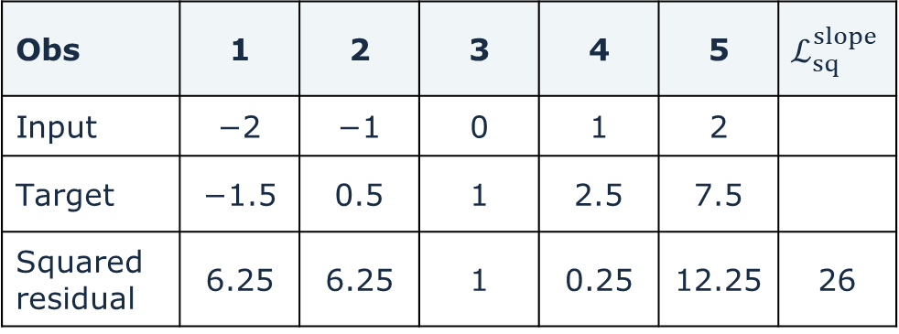

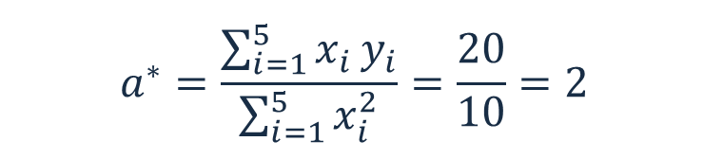
The fitted line through the origin
Obs | 1 | 2 | 3 | 4 | 5 | $$ℒ_{sq}^{slope}$$
Input | −2 | −1 | 0 | 1 | 2
Target | −1.5 | 0.5 | 1 | 2.5 | 7.5
Squared residual | 6.25 | 6.25 | 1 | 0.25 | 12.25 | 26
$$a^{∗}=\frac{\sum_{i=1}^{5}{x_{i}}y_{i}}{\sum_{i=1}^{5}{x_{i}^{2}}}=\frac{20}{10}=2$$
$$ℒ_{sq}^{slope}\left(a^{∗}\right)=26$$
On these data, this fit improves on the best constant, for which $ℒ_{sq}^{const}\left(b^{∗}\right)=\text{46}\text{.}$
19
Notes:
Source: SEMTM0051_week2_linear_regression_final (2)(1).tex, supplied by Roberto Colomboni.

Slide 22

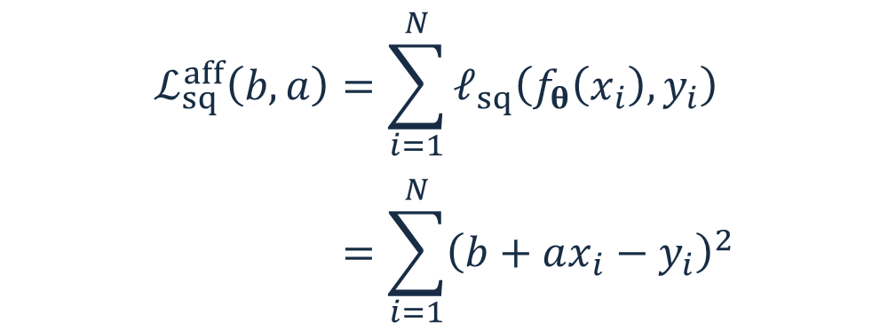
Fitting both slope and intercept
Now both coefficients vary. We collect them in a column vector.
$$θ=\left(\begin{matrix}b \\ a\end{matrix}\right), f_{θ}\left(x\right)=b+ax$$
$$ℒ_{sq}^{aff}\left(b,a\right)=\sum_{i=1}^{N}{ℓ_{sq}\left(f_{θ}\left(x_{i}\right),y_{i}\right)}$$
$$=\sum_{i=1}^{N}{{\left(b+ax_{i}−y_{i}\right)}^{2}}$$
The objective is now a function of two parameters.
20
Notes:
Both the intercept b and the slope a are adjustable. The line in the chart is one member of this family. The loss is a function of the parameter pair, with the observations held fixed.

Slide 23



Affine loss: the intercept derivative
$$ℒ_{sq}^{aff}\left(b,a\right)=\sum_{i=1}^{N}{{\left(b+ax_{i}−y_{i}\right)}^{2}}=\sum_{i=1}^{N}{r_{i}}{\left(b,a\right)}^{2}$$
where $r_{i}\left(b,a\right)=b+ax_{i}−y_{i}$ is the i-th residual, so $\frac{∂r_{i}}{∂b}\left(b,a\right)=1$.
The chain rule, with outer function $u\left(r\right)=r^{2}$ and inner functions $r_{i}$, gives
$$\frac{∂ℒ_{sq}^{aff}}{∂b}\left(b,a\right)=\sum_{i=1}^{N}{\frac{∂}{∂b}\left(r_{i}{\left(b,a\right)}^{2}\right)}=\sum_{i=1}^{N}{2r_{i}\left(b,a\right)\frac{∂r_{i}}{∂b}\left(b,a\right)}$$
$$=2\sum_{i=1}^{N}{\left(b+ax_{i}−y_{i}\right)}=2\left(Nb+a\sum_{i=1}^{N}{x_{i}}−\sum_{i=1}^{N}{y_{i}}\right)$$
Hold $a$ fixed: only $b$ varies. The data $x_{i}$ and $y_{i}$ are fixed.
21
Notes:
Write the affine empirical squared loss explicitly and then as a sum of squared residuals. Hold a fixed and differentiate with respect to b. Apply the chain rule to every squared residual, substitute the residual derivative, and collect the terms. The observations are fixed throughout.

Slide 24


Affine loss: the slope derivative
$$ℒ_{sq}^{aff}\left(b,a\right)=\sum_{i=1}^{N}{{\left(b+ax_{i}−y_{i}\right)}^{2}}=\sum_{i=1}^{N}{r_{i}}{\left(b,a\right)}^{2}$$
where $r_{i}\left(b,a\right)=b+ax_{i}−y_{i}$ is the i-th residual, so $\frac{∂r_{i}}{∂a}\left(b,a\right)=x_{i}$.
The chain rule, with outer function $u\left(r\right)=r^{2}$ and inner functions $r_{i}$, gives
$$\frac{∂ℒ_{sq}^{aff}}{∂a}\left(b,a\right)=\sum_{i=1}^{N}{\frac{∂}{∂a}}\left(r_{i}{\left(b,a\right)}^{2}\right)=\sum_{i=1}^{N}{2r_{i}\left(b,a\right)}\frac{∂r_{i}}{∂a}\left(b,a\right)$$
$$=2\sum_{i=1}^{N}{x_{i}}\left(b+ax_{i}−y_{i}\right)=2\left(b\sum_{i=1}^{N}{x_{i}}+a\sum_{i=1}^{N}{x_{i}^{2}}−\sum_{i=1}^{N}{x_{i}}y_{i}\right)$$
Hold $b$ fixed: only $a$ varies. The data $x_{i}$ and $y_{i}$ are fixed.
22
Notes:
Write the affine empirical squared loss explicitly and then as a sum of squared residuals. Hold b fixed and differentiate with respect to a. Apply the chain rule to every squared residual, substitute the residual derivative, and collect the terms. The observations are fixed throughout.

Slide 25


The stationarity equations
Set both partial derivatives of $ℒ_{sq}^{aff}$ to zero and divide by two.
$$\frac{∂ℒ_{sq}^{aff}}{∂b}\left(b,a\right)=0 ⇔ Nb+a\sum_{i=1}^{N}{x_{i}}=\sum_{i=1}^{N}{y_{i}}$$
$$\frac{∂ℒ_{sq}^{aff}}{∂a}\left(b,a\right)=0 ⇔ b\sum_{i=1}^{N}{x_{i}}+a\sum_{i=1}^{N}{x_{i}^{2}}=\sum_{i=1}^{N}{x_{i}y_{i}}$$
This is a linear system in the unknowns $b$ and $a$.
23
Notes:
Source: SEMTM0051_week2_linear_regression_final (2)(1).tex, supplied by Roberto Colomboni.

Slide 26
Solving the system
Define the empirical means
$$\overline{x}=\frac{1}{N}\sum_{i=1}^{N}{x_{i}}, \overline{y}=\frac{1}{N}\sum_{i=1}^{N}{y_{i}}$$
24
Notes:
Source: SEMTM0051_week2_linear_regression_final (2)(1).tex, supplied by Roberto Colomboni.

Slide 27


The stationarity equations
Set both partial derivatives of $ℒ_{sq}^{aff}$ to zero and divide by two.
$$\frac{∂ℒ_{sq}^{aff}}{∂b}\left(b,a\right)=0 ⇔ Nb+aN\overline{x}=N\overline{y}$$
$$\frac{∂ℒ_{sq}^{aff}}{∂a}\left(b,a\right)=0 ⇔ bN\overline{x}+a\sum_{i=1}^{N}{x_{i}^{2}}=\sum_{i=1}^{N}{x_{i}y_{i}}$$
This is a linear system in the unknowns $b$ and $a$.
25
Notes:
Source: SEMTM0051_week2_linear_regression_final (2)(1).tex, supplied by Roberto Colomboni.

Slide 28

Solving the system
Define the empirical means
$$\overline{x}=\frac{1}{N}\sum_{i=1}^{N}{x_{i}}, \overline{y}=\frac{1}{N}\sum_{i=1}^{N}{y_{i}}$$
The first equation gives the intercept in terms of the slope.
$$b=\overline{y}−a\overline{x}$$
Substitute this expression into the second equation.
$$a\left(\sum_{i=1}^{N}{x_{i}^{2}}−N{\overline{x}}^{2}\right)=\sum_{i=1}^{N}{x_{i}y_{i}}−N\overline{x} \overline{y}$$
26
Notes:
Source: SEMTM0051_week2_linear_regression_final (2)(1).tex, supplied by Roberto Colomboni.

Slide 29

The best slope and intercept
Assume the inputs are not all equal. Then the denominator below is positive.
$$a^{⋆}=\frac{\sum_{i=1}^{N}{x_{i}}y_{i}−N\overline{x} \overline{y}}{\sum_{i=1}^{N}{x_{i}^{2}}−N{\overline{x}}^{2}}=\frac{\sum_{i=1}^{N}{\left(x_{i}−\overline{x}\right)\left(y_{i}−\overline{y}\right)}}{\sum_{i=1}^{N}{{\left(x_{i}−\overline{x}\right)}^{2}}}$$
$$b^{⋆}=\overline{y}−a^{⋆}\overline{x}$$
We have found a unique stationary point.
Is it a global minimum?
27
Notes:
Assume the inputs are not all equal, so the denominator is positive. The normal equations have a unique solution. The next two slides prove that this stationary point is a global minimum by expanding the squared residuals, without appealing to convexity.

Slide 30

Residuals at the stationary point
Let $\left(b^{⋆},a^{⋆}\right)$ be the stationary point. Its residuals are
$$r_{i}^{⋆}=b^{⋆}+a^{⋆}x_{i}−y_{i}, i=1,…,N.$$
The zero-gradient (stationary point) conditions say precisely that
$$\sum_{i=1}^{N}{r_{i}^{⋆}}=0, \sum_{i=1}^{N}{x_{i}r_{i}^{⋆}}=0.$$
Any other parameter pair is $\left(b^{⋆}+u,a^{⋆}+v\right)$, with $u,v∈ℝ$.
The corresponding residuals are
$$\left(b^{⋆}+u\right)+\left(a^{⋆}+v\right)x_{i}−y_{i}=r_{i}^{⋆}+u+vx_{i}.$$
28
Notes:
Define the residuals at the stationary point. The two zero-gradient equations give sum_i r_i*=0 and sum_i x_i r_i*=0. Now compare the stationary point with any other parameter pair by writing the change in intercept as u and the change in slope as v. The new residual is r_i*+u+v x_i. Both u and v are arbitrary real numbers.

Slide 31


A global minimum
Expanding the squared residuals gives
$$ℒ_{sq}^{aff}\left(b^{⋆}+u,a^{⋆}+v\right)=\sum_{i=1}^{N}{{\left(r_{i}^{⋆}+u+vx_{i}\right)}^{2}}$$
$$=ℒ_{sq}^{aff}\left(b^{⋆},a^{⋆}\right)+2u\underset{=0}{\underbrace{\sum_{i=1}^{N}{r_{i}^{⋆}}}}+2v\underset{=0}{\underbrace{\sum_{i=1}^{N}{x_{i}r_{i}^{⋆}}}}+\underset{≥0}{\underbrace{\sum_{i=1}^{N}{{\left(u+vx_{i}\right)}^{2}}}}$$
$$≥ ℒ_{sq}^{aff}\left(b^{⋆},a^{⋆}\right)$$
Thus $\left(b^{⋆},a^{⋆}\right)$ is a global minimiser.
If the inputs are not all equal, equality forces $u=v=0$: the minimiser is unique.
29
Notes:
Expand each square. The cross terms are 2u times sum_i r_i* and 2v times sum_i x_i r_i*, so both vanish by stationarity. The remaining difference in loss is sum_i (u+v x_i)^2, which is nonnegative for every u and v. Hence the stationary point is a global minimiser. Equality requires u+v x_i=0 for every i. If two inputs differ, subtract their equations to obtain v=0, then u=0. The minimiser is therefore unique under the stated assumption.

Slide 32
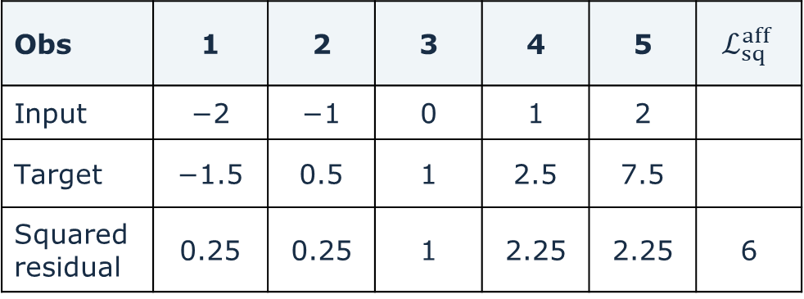

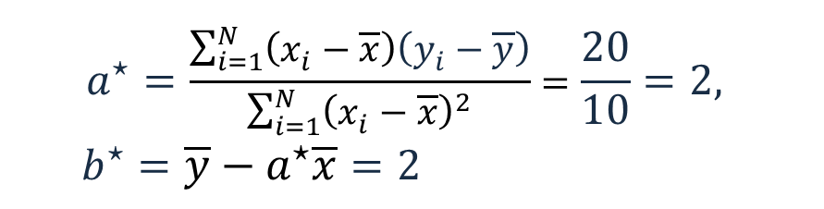


The affine fit on our data
Obs | 1 | 2 | 3 | 4 | 5 | $$ℒ_{sq}^{aff}$$
Input | −2 | −1 | 0 | 1 | 2
Target | −1.5 | 0.5 | 1 | 2.5 | 7.5
Squared residual | 0.25 | 0.25 | 1 | 2.25 | 2.25 | 6
$$\overset{‾}{x}=0, \overset{‾}{y}=2$$
$$a^{⋆}=\frac{\sum_{i=1}^{N}{\left(x_{i}−\overline{x}\right)\left(y_{i}−\overline{y}\right)}}{\sum_{i=1}^{N}{{\left(x_{i}−\overline{x}\right)}^{2}}}=\frac{20}{10}=2,$$
$$b^{⋆}=\overline{y}−a^{⋆}\overline{x}=2$$
$$θ^{⋆}=\left({b^{⋆} \atop a^{⋆}}\right), f_{θ^{⋆}}\left(x\right)=2+2x$$
$$ℒ_{sq}^{aff}\left(θ^{⋆}\right)=ℒ_{sq}^{aff}\left(b^{⋆},a^{⋆}\right)=6$$
This fit improves on the best slope-only and constant predictors:
$$ℒ_{sq}^{slope}\left(a^{∗}\right)=26, ℒ_{sq}^{const}\left(b^{∗}\right)=46.$$
30
Notes:
For the five observations, x-bar = 0 and y-bar = 2. The normal equations give a-star = 2 and b-star = 2. Predictions are (-2,0,2,4,6), signed residuals are (-0.5,-0.5,1,1.5,-1.5), and squared residuals are (0.25,0.25,1,2.25,2.25). Their sum is 6. Compare the minimum 26 for the slope-only family and 46 for the constant family. The fitted affine line need not pass through an observation.

Slide 33
Today's lecture
Regression and loss functions
Least-squares fitting
Gradient descent
Extensions
31
Notes:
For this two-parameter model, the exact solution is easy to compute. The purpose of gradient descent here is to learn an iterative method that also applies to more complex models. All subsequent calculations in this section use the affine loss as a function of b and a. No matrix notation is needed yet.

Slide 34
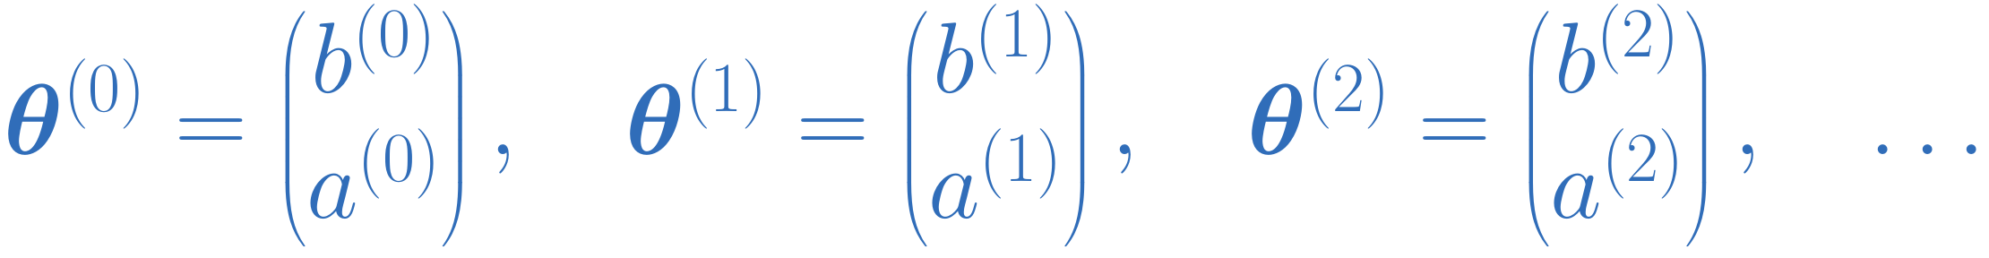
An iterative approach
For the affine model, we can calculate the best slope and intercept explicitly.
More complex models may have no explicit solution.
However, we can still use gradients to improve the parameters.
Can we also approach the minimum by improving an initial guess, step by step?
$$θ^{\left(0\right)}=\left(\begin{aligned}b^{\left(0\right)} \\ a^{\left(0\right)}\end{aligned}\right), θ^{\left(1\right)}=\left(\begin{aligned}b^{\left(1\right)} \\ a^{\left(1\right)}\end{aligned}\right), θ^{\left(2\right)}=\left(\begin{aligned}b^{\left(2\right)} \\ a^{\left(2\right)}\end{aligned}\right), …$$
We will use the gradients to choose each update.
32
Notes:
For this affine model an explicit solution is available. More complex models may have no explicit solution, but we can still use gradients to improve an initial guess. Introduce the sequence of parameter vectors, then connect it to the local approximation on the next slide.

Slide 35
A local linear approximation
For the squared loss $ℒ_{sq}^{aff}$, differentiability gives a local linear approximation.
$$ℒ_{sq}^{aff}\left(b+Δb,a+Δa\right)≈ℒ_{sq}^{aff}\left(b,a\right)+{\left(∇ℒ_{sq}^{aff}\left(b,a\right)\right)}^{⊤}\left(\begin{aligned}Δb \\ Δa\end{aligned}\right)$$
For a sufficiently small step size $η>0$, if we choose
$$\left(\begin{aligned}Δb \\ Δa\end{aligned}\right)=−η{\left(\frac{∂ℒ_{sq}^{aff}}{∂b}\left(b,a\right), \frac{∂ℒ_{sq}^{aff}}{∂a}\left(b,a\right)\right)}^{⊤}=−η∇ℒ_{sq}^{aff}\left(b,a\right)$$
we obtain
$$ℒ_{sq}^{aff}\left(b+Δb,a+Δa\right)≈ℒ_{sq}^{aff}\left(b,a\right)−η{\left\|∇ℒ_{sq}^{aff}\left(b,a\right)\right\|}_{2}^{2}<ℒ_{sq}^{aff}\left(b,a\right)$$
If the gradient is nonzero,
a small enough step in its opposite direction decreases the loss.
33
Notes:
The local linear approximation motivates choosing each increment as a negative multiple of the corresponding partial derivative. With eta positive, the first-order change is minus eta times the sum of the squared partials. If either partial is nonzero, sufficiently small positive eta decreases the loss. The following slides write the iterative updates and identify their vector form as gradient descent.

Slide 36


The two updates form a gradient step
The partial derivatives are the components of the gradient.
$$θ=\left(\begin{matrix}b \\ a\end{matrix}\right), ∇ℒ_{sq}^{aff}\left(θ\right)={\left(\frac{∂ℒ_{sq}^{aff}}{∂b}\left(b,a\right),\frac{∂ℒ_{sq}^{aff}}{∂a}\left(b,a\right)\begin{matrix} \\ \end{matrix}\right)}^{⊤}$$
The two scalar updates give a single displacement in the parameter plane.
$$θ^{\left(t+1\right)}=θ^{\left(t\right)}−η∇ℒ_{sq}^{aff}\left(θ^{\left(t\right)}\right), θ^{\left(t\right)}=\left(\begin{matrix}b^{\left(t\right)} \\ a^{\left(t\right)}\end{matrix}\right)$$
Each step points in the direction of the negative gradient.
34
Notes:
The two partial derivatives form the gradient in parameter order (b, a). The simultaneous scalar updates are exactly a step of minus eta times that gradient. For positive eta the step points opposite to the gradient. The preceding slide explains why sufficiently small steps decrease the loss.

Slide 37
Gradient descent: successive predictors
Same observations, updated coefficients. The learning rate is $η=0.04$.
Predictions on the observed inputs
Path in the parameter plane
$$t=0 \left(b^{\left(0\right)},a^{\left(0\right)}\right)=\left(0,0\right) ℒ_{sq}^{aff}\left(θ^{\left(0\right)}\right)=66$$
35
Notes:
Iteration 0. The initial coefficients are b=0 and a=0, so every prediction is zero. The point in parameter space is the origin. The sum of squared residuals is 66. The next slide shows the first update with learning rate 0.04.
Source: SEMTM0051_week2_linear_regression_final (2)(1).tex, supplied by Roberto Colomboni.

Slide 38
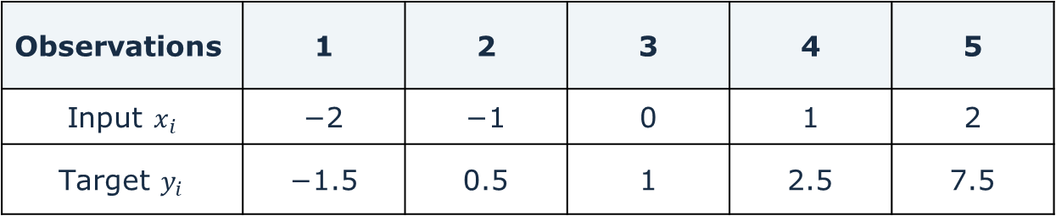
Gradient descent: the first step
Observations | 1 | 2 | 3 | 4 | 5
Input $x_{i}$ | −2 | −1 | 0 | 1 | 2
Target $y_{i}$ | −1.5 | 0.5 | 1 | 2.5 | 7.5
$$θ^{(0)}={\left(b^{\left(0\right)},a^{\left(0\right)}\right)}^{⊤}={\left(0,0\right)}^{⊤}, η=0.04$$
$$\frac{∂ℒ_{sq}^{aff}}{∂b}\left(0,0\right)=−2\sum_{i=1}^{5}{y_{i}}=−2⋅10=−20$$
$$\frac{∂ℒ_{sq}^{aff}}{∂a}\left(0,0\right)=−2\sum_{i=1}^{5}{x_{i}y_{i}}=−2⋅20=−40$$
$$θ^{(1)}=θ^{(0)}−η∇ℒ_{sq}^{aff}\left(θ^{\left(0\right)}\right)=\left(\begin{matrix}0 \\ 0\end{matrix}\right)−0.04⋅\left(\begin{matrix}−20 \\ −40\end{matrix}\right)=\left(\begin{matrix}0.8 \\ 1.6\end{matrix}\right)$$
$$f_{θ^{(1)}}\left(x\right)=0.8+1.6x$$
36
Notes:
For these five observations, sum y_i = 10 and sum x_i y_i = 20. At b = a = 0, the gradient is (-20,-40)^T. With eta = 0.04, update both coefficients simultaneously to obtain b = 0.8 and a = 1.6. Reveal the two derivatives separately, followed by the update and its predictor.

Slide 39
Gradient descent: successive predictors
Same observations, updated coefficients. The learning rate is $η=0.04$.
Predictions on the observed inputs
Path in the parameter plane
$$t=1 \left(b^{\left(1\right)},a^{\left(1\right)}\right)=\left(0.8,1.6\right) ℒ_{sq}^{aff}\left(θ^{\left(1\right)}\right)=14.8$$
37
Notes:
Iteration 1. The data-space graph and the parameter-space point correspond to the same coefficients. The pale ellipses are level sets of the empirical loss. All numeric results use a sum of squares, not its mean.
Source: SEMTM0051_week2_linear_regression_final (2)(1).tex, supplied by Roberto Colomboni.

Slide 40
Gradient descent: successive predictors
Same observations, updated coefficients. The learning rate is $η=0.04$.
Predictions on the observed inputs
Path in the parameter plane
$$t=2 \left(b^{\left(2\right)},a^{\left(2\right)}\right)=\left(1.28,1.92\right) ℒ_{sq}^{aff}\left(θ^{\left(2\right)}\right)=8.656$$
38
Notes:
Iteration 2. The data-space graph and the parameter-space point correspond to the same coefficients. The pale ellipses are level sets of the empirical loss. All numeric results use a sum of squares, not its mean.
Source: SEMTM0051_week2_linear_regression_final (2)(1).tex, supplied by Roberto Colomboni.

Slide 41
Gradient descent: successive predictors
Same observations, updated coefficients. The learning rate is $η=0.04$.
Predictions on the observed inputs
Path in the parameter plane
$$t=5 \left(b^{\left(5\right)},a^{\left(5\right)}\right)=\left(1.84448,1.99936\right) ℒ_{sq}^{aff}\left(θ^{\left(5\right)}\right)=6.12094$$
39
Notes:
Iteration 5. The data-space graph and the parameter-space point correspond to the same coefficients. The pale ellipses are level sets of the empirical loss. All numeric results use a sum of squares, not its mean.
Source: SEMTM0051_week2_linear_regression_final (2)(1).tex, supplied by Roberto Colomboni.

Slide 42
Today's lecture
Regression and loss functions
Least-squares fitting
Gradient descent
Extensions
40
Notes:
Extensions. First allow a nonlinear dependence on one scalar input by using fixed features. Then allow several input variables, using salary prediction as the example. State the explicit solution and gradient-descent update in each case, without additional derivations.

Slide 43

Extension 1: nonlinear predictors
So far, our predictors have been affine in the input.
Can we also use predictors that are nonlinear in the input?
Example
$f_{θ}\left(x\right)=b+w_{1}x+w_{2}x^{2}$, $θ={\left(b,w_{1},w_{2}\right)}^{⊤}∈ℝ^{3×1}$
$$φ\left(x\right)=\left(1,x,x^{2}\right)∈ℝ^{1×3}, f_{θ}\left(x\right)=φ\left(x\right)θ$$
The predictor may be nonlinear in $x$
while remaining linear in the adjustable coefficients
41
Notes:
Source: SEMTM0051_week2_linear_regression_final (2)(1).tex, supplied by Roberto Colomboni.

Slide 44
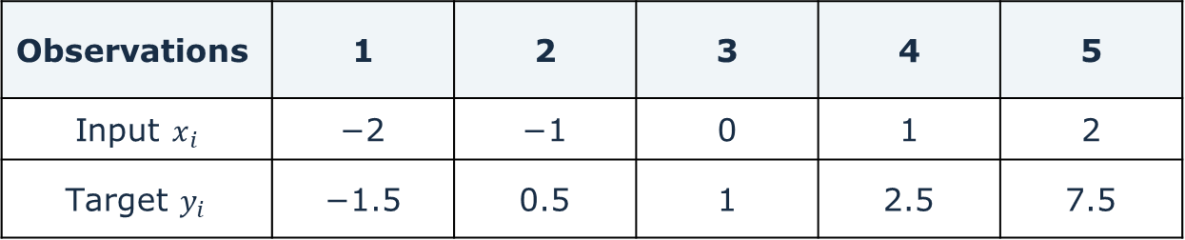
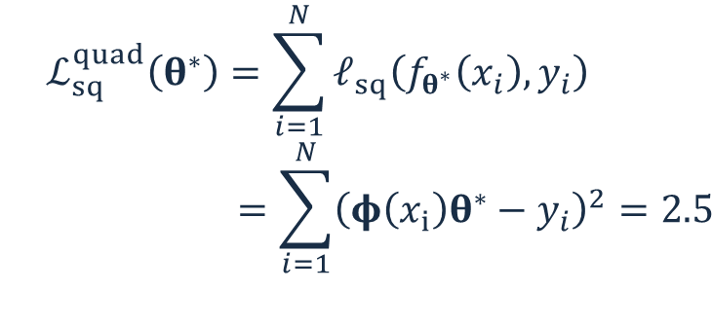


A quadratic fit to the same observations
Observations | 1 | 2 | 3 | 4 | 5
Input $x_{i}$ | −2 | −1 | 0 | 1 | 2
Target $y_{i}$ | −1.5 | 0.5 | 1 | 2.5 | 7.5
$$φ\left(x\right)=\left(1,x,x^{2}\right)$$
$$θ^{∗}={\left(1,2,0.5\right)}^{⊤}$$
$$ℒ_{sq}^{quad}\left(θ^{∗}\right)=\sum_{i=1}^{N}{ℓ_{sq}\left(f_{θ^{∗}}\left(x_{i}\right),y_{i}\right)}$$
$$=\sum_{i=1}^{N}{{\left(φ\left(x_{i}\right)θ^{∗}−y_{i}\right)}^{2}}=2.5$$
42
Notes:
Rows of Phi correspond to observations and columns to fixed features. For the quadratic example, choose phi_1(x)=1, phi_2(x)=x, phi_3(x)=x^2. The coefficients are the only quantities being fitted. No derivation is needed for the formulas on the next slide.

Slide 45

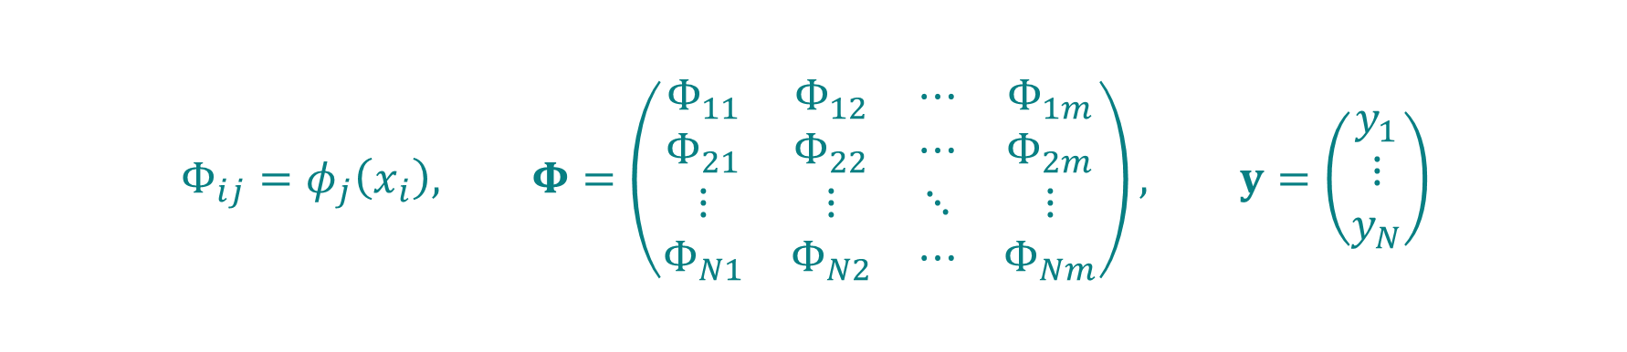

Fixed feature expansion
Choose fixed feature functions $φ_{1},…,φ_{m}:ℝ→ℝ$
and define $φ\left(x\right)≔\left(φ_{1}\left(x\right),…,φ_{m}\left(x\right)\right)$.
For a column vector $θ={\left(θ_{1},…,θ_{m}\right)}^{⊤}∈ℝ^{m×1}$ of parameters, define the predictor
$$f_{θ}\left(x\right)=φ\left(x\right)θ=\sum_{j=1}^{m}{θ_{j}φ_{j}\left(x\right)}$$
Define the feature matrix $Φ∈ℝ^{N×m}$ and the column of observations $y∈ℝ^{N×1}$ by
$$Φ_{ij}=φ_{j}\left(x_{i}\right), Φ=\left(\begin{matrix}Φ_{11} & Φ_{12} & ⋯ & Φ_{1m} \\ Φ_{21} & Φ_{22} & ⋯ & Φ_{2m} \\ ⋮ & ⋮ & ⋱ & ⋮ \\ Φ_{N1} & Φ_{N2} & ⋯ & Φ_{Nm}\end{matrix}\right), y=\left(\begin{aligned}y_{1} \\ ⋮ \\ y_{N}\end{aligned}\right)$$
43
Notes:
A fixed nonlinear feature map extends the model while keeping it linear in its coefficients. The constant feature represents the bias. The next slide shows the quadratic fit on exactly the same five observations.

Slide 46

Feature expansion: fitting the coefficients
Then the quadratic loss can be expressed as
$$ℒ_{sq}\left(θ\right)=\sum_{i=1}^{N}{ℓ_{sq}\left(f_{θ}\left(x_{i}\right),y_{i}\right)}={\left\|Φθ−y\right\|}_{2}^{2}$$
Gradient
$$∇ℒ_{sq}\left(θ\right)=2Φ^{⊤}\left(Φθ−y\right)$$
If the matrix $Φ^{⊤}Φ$ is invertible,
The unique stationary point and global minimiser $θ^{∗}$ is given by
$$θ^{∗}={\left(Φ^{⊤}Φ\right)}^{−1}Φ^{⊤}y$$
Gradient descent
$$θ^{\left(t+1\right)}=θ^{\left(t\right)}−η∇ℒ_{sq}\left(θ^{\left(t\right)}\right)=θ^{\left(t\right)}−2ηΦ^{⊤}\left(Φθ^{\left(t\right)}−y\right)$$
44
Notes:
State both results without derivation. The explicit inverse requires full column rank. The gradient is 2 Phi^T(Phi w-y), so the iteration is the same gradient-descent rule used for the affine model. A sufficient constant step-size condition, when Phi is nonzero, is 0 < eta < 1/lambda_max(Phi^T Phi). This condition is not needed on the slide.

Slide 47


Extension 2: several input variables
Can we predict salary $y$ from age, education and years of experience?
An observation may contain several input features.
$$x=\left(x_{1},…,x_{d}\right)∈ℝ^{1×d},$$
We associate one weight with each feature, together with a bias (intercept).
$$b∈ℝ, w={\left(w_{1},…,w_{d}\right)}^{⊤}∈ℝ^{d×1}, θ≔\left(\begin{aligned}b \\ w\end{aligned}\right)∈ℝ^{\left(d+1\right)×1}$$
The resulting linear predictor is then
$$f_{θ}\left(x\right)=\left(1,x\right)θ=b+xw=b+\sum_{j=1}^{d}{x_{j}w_{j}}$$
45
Notes:
Results only from this point through fixed-feature linear regression, as requested. Input rows and weight columns follow the course notation.
Source: SEMTM0051_week2_linear_regression_final (2)(1).tex, supplied by Roberto Colomboni.

Slide 48


The design matrix
To handle all N observations $\left(x_{1},y_{1}\right),…,\left(x_{N},y_{N}\right)$at once,
we stack the data into $X∈ℝ^{N×\left(d+1\right)}$ and observations into $y∈ℝ^{N×1}$
$$X=\left(\begin{matrix}1 & x_{1} \\ ⋮ & ⋮ \\ 1 & x_{N}\end{matrix}\right)=\left(\begin{matrix}1 & x_{11} & ⋯ & x_{1d} \\ ⋮ & ⋮ & & ⋮ \\ 1 & x_{N1} & ⋯ & x_{Nd}\end{matrix}\right), y=\left(\begin{matrix}y_{1} \\ ⋮ \\ y_{N}\end{matrix}\right)$$
Each row represents one observation.
Each column represents a feature.
The first column contains ones and accounts for the bias.
46
Notes:
Source: SEMTM0051_week2_linear_regression_final (2)(1).tex, supplied by Roberto Colomboni.

Slide 49
Several inputs: solution and gradient descent
Then the quadratic loss can be expressed as
$$ℒ_{sq}\left(θ\right)=\sum_{n=1}^{N}{ℓ_{sq}\left(f_{θ}\left(x_{n}\right),y_{n}\right)}={\left\|Xθ−y\right\|}_{2}^{2}$$
Gradient and gradient descent
$$∇ℒ_{sq}\left(θ\right)=2X^{⊤}\left(Xθ−y\right)$$
If the matrix $X^{⊤}X$ is invertible,
The unique stationary point and global minimiser $θ^{∗}$ is given by
$$θ^{∗}={\left(X^{⊤}X\right)}^{−1}X^{⊤}y$$
Gradient descent
$$θ^{\left(t+1\right)}=θ^{\left(t\right)}−η∇ℒ_{sq}\left(θ^{\left(t\right)}\right)=θ^{\left(t\right)}−2ηX^{⊤}\left(Xθ^{\left(t\right)}−y\right)$$
47
Notes:
State both results without derivation. These are the same formulas as for fixed feature expansion, with X in place of Phi and theta in place of w. The first coefficient is the intercept. The inverse requires independent columns. For a nonzero design matrix, 0 < eta < 1/lambda_max(X^T X) ensures convergence of gradient descent for this sum-of-squares convention.

Slide 50

Lecture notes and exercises
The notes for today's lecture are available
on the course GitHub page.
They explain the material in more detail
and include exercises.
I will post the exercise solutions
before the next lecture.
github.com/semtm0051/2026_27
Scan for course materials
48
Notes:
Course materials: https://github.com/semtm0051/2026_27. The lecture notes cover today's material in more detail and include exercises. Each week, the lecturer will post the exercise solutions before the next lecture. The visible link and QR code point to the same course repository. Wording and publication schedule supplied by the lecturer.

